Slide 1
Gene Linkage and Mapping
Genes can be mapped to specific locations on chromosomes.

Slide 2
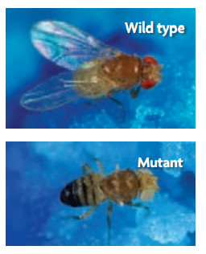
Gene linkage was explained through fruit flies.
American scientist Thomas Hunt Morgan, wanted to prove how could genes be linked and still follow Mendel’s law of independent assortment. Morgan chose the fruit flies (Drosophila) because he could quickly and cheaply grow new generations of flies. He observed among fruit flies easily identifiable variations in eye color, body color, and wing shape.
He found a mutation in a gene affecting fly eye color. This mutation made a fly's eyes white, rather than their normal red. And he called that mutant or individual flies that had atypical, heritable characteristics. Unexpectedly, Morgan found that the eye color gene was inherited in different patterns by male and female flies.
Then he set up experiments similar to Mendel’s dihybrid crosses. Morgan took the white mutant(which was male) and bred it with pure red-eyed female flies. All of the females that resulted from that breeding in the F1 generation had red eyes. But when the F1 flies were crossed to each other, all of the female F2 flies were red-eyed, while about half of the male F2​ flies were white-eyed. Morgan discovered that inheritance pattern was not shared equally across males and females. That result indicated that the flies did not follow Mendel’s ratio in a traditional sense.
Morgan hypothesized that a factor, or gene, controlling eye color in flies was on the same chromosome that determined sex (located on the X chromosome).That result indicated that eye color and sex were both tied to chromosomes.

Slide 3
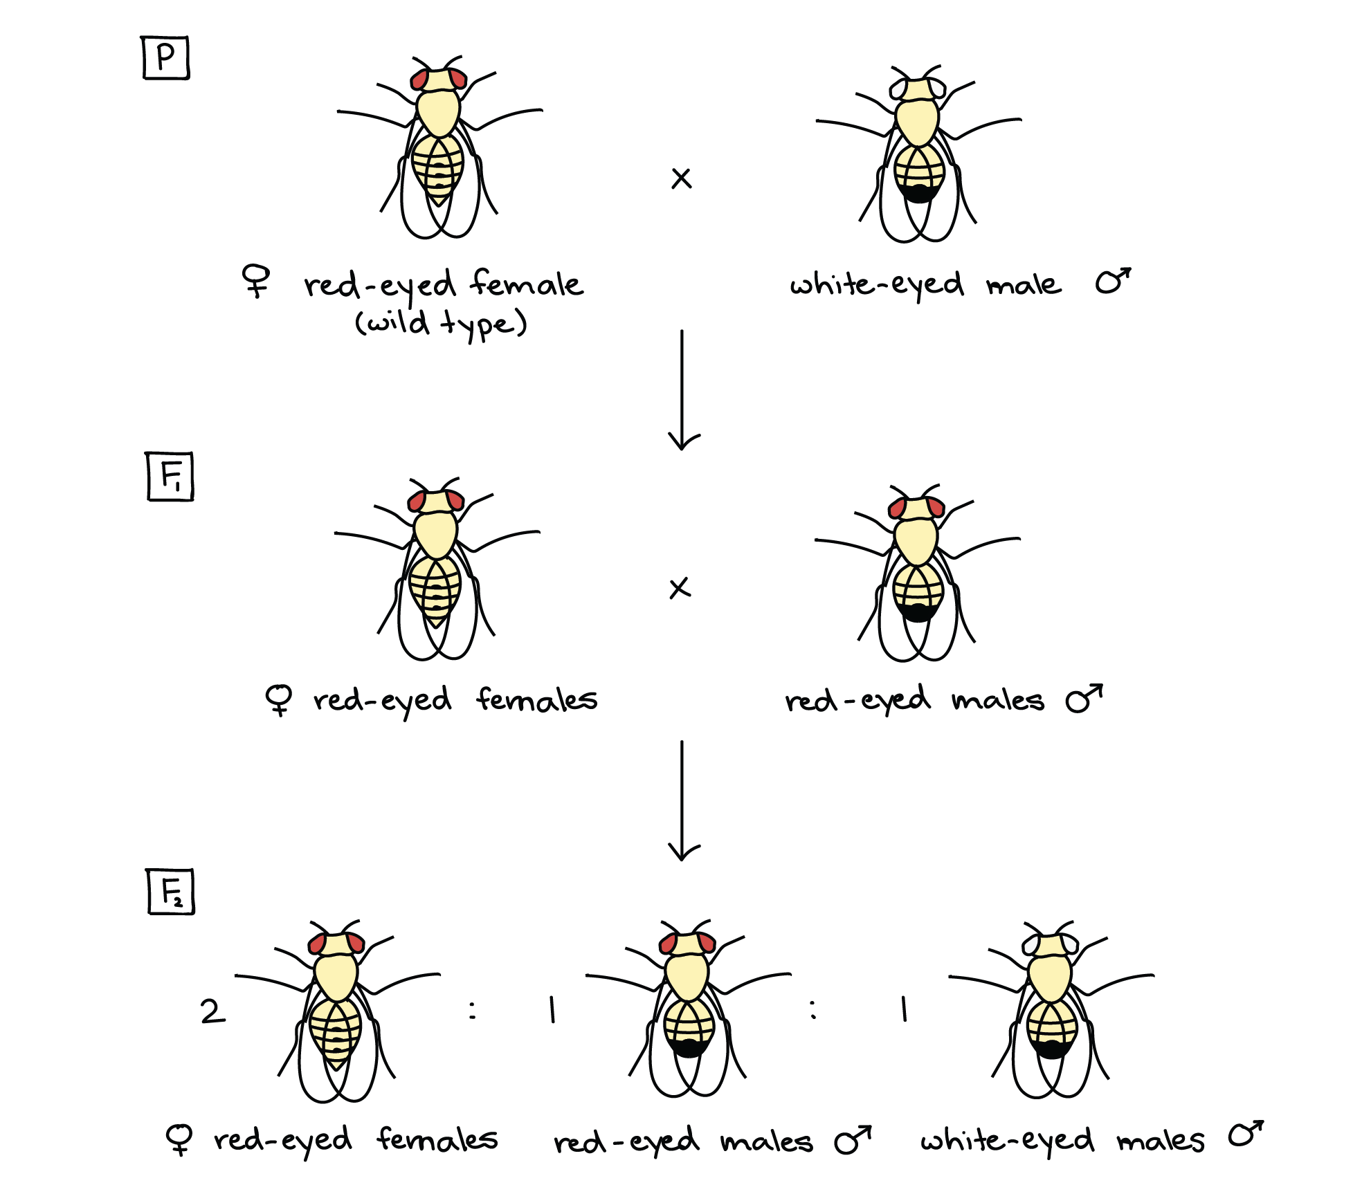

Slide 4
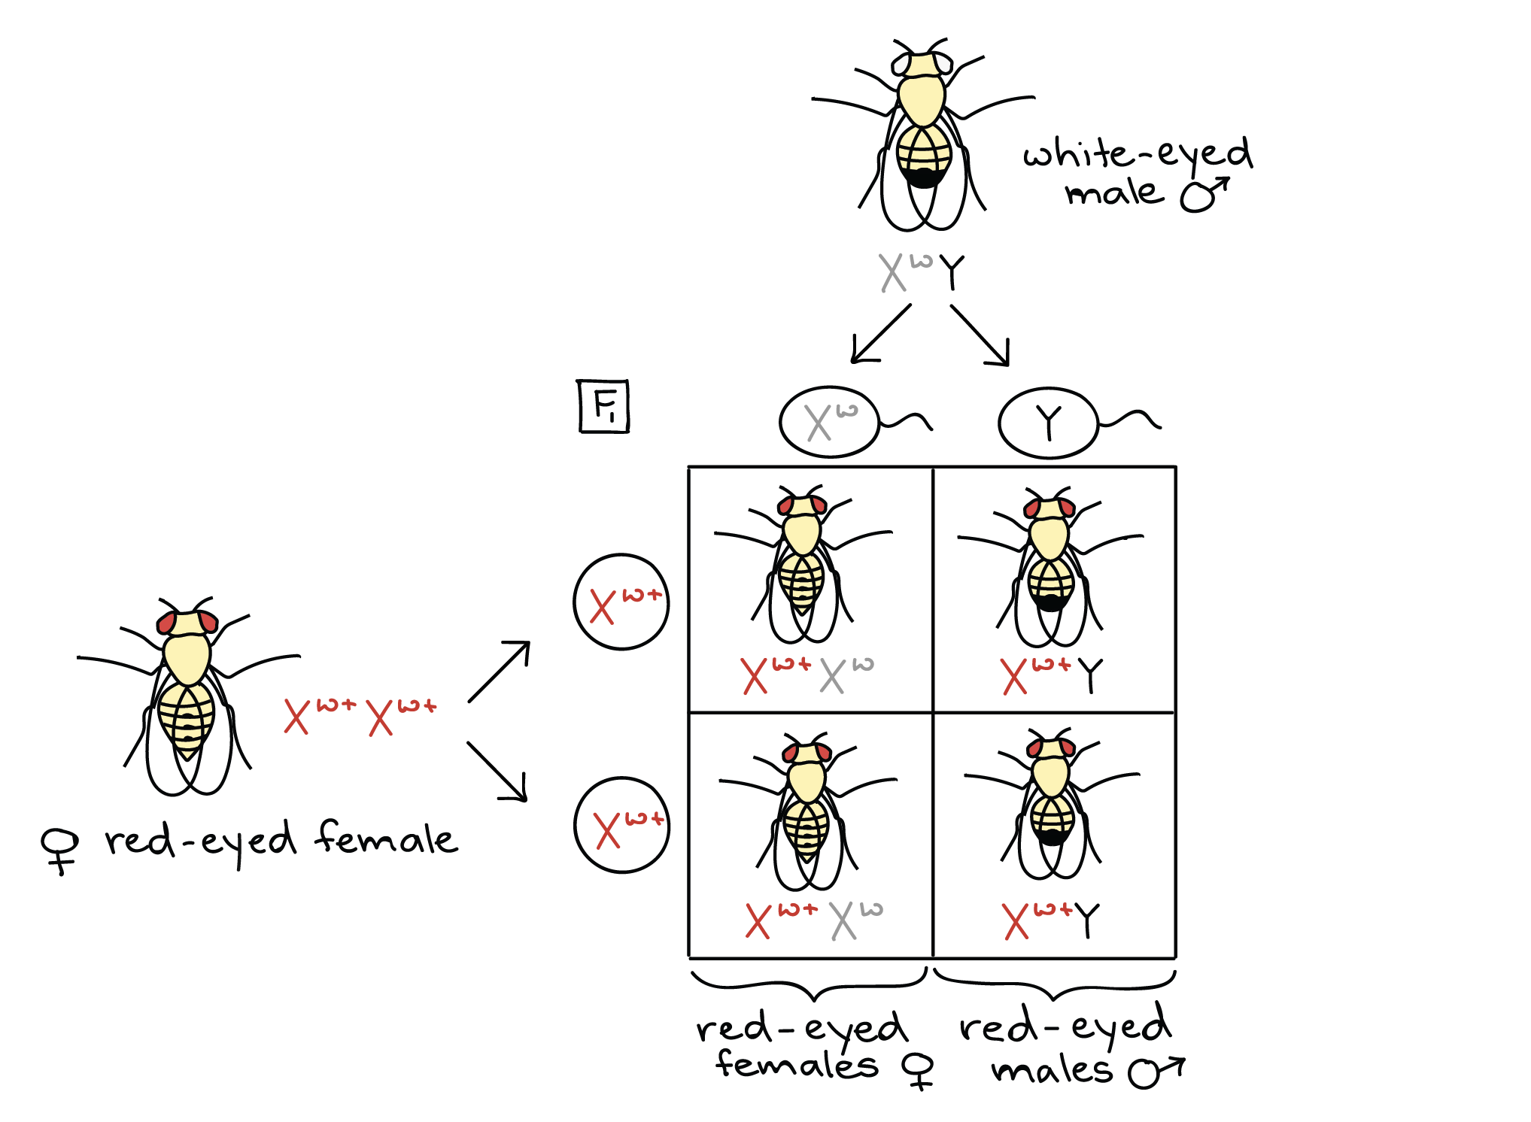

Slide 5
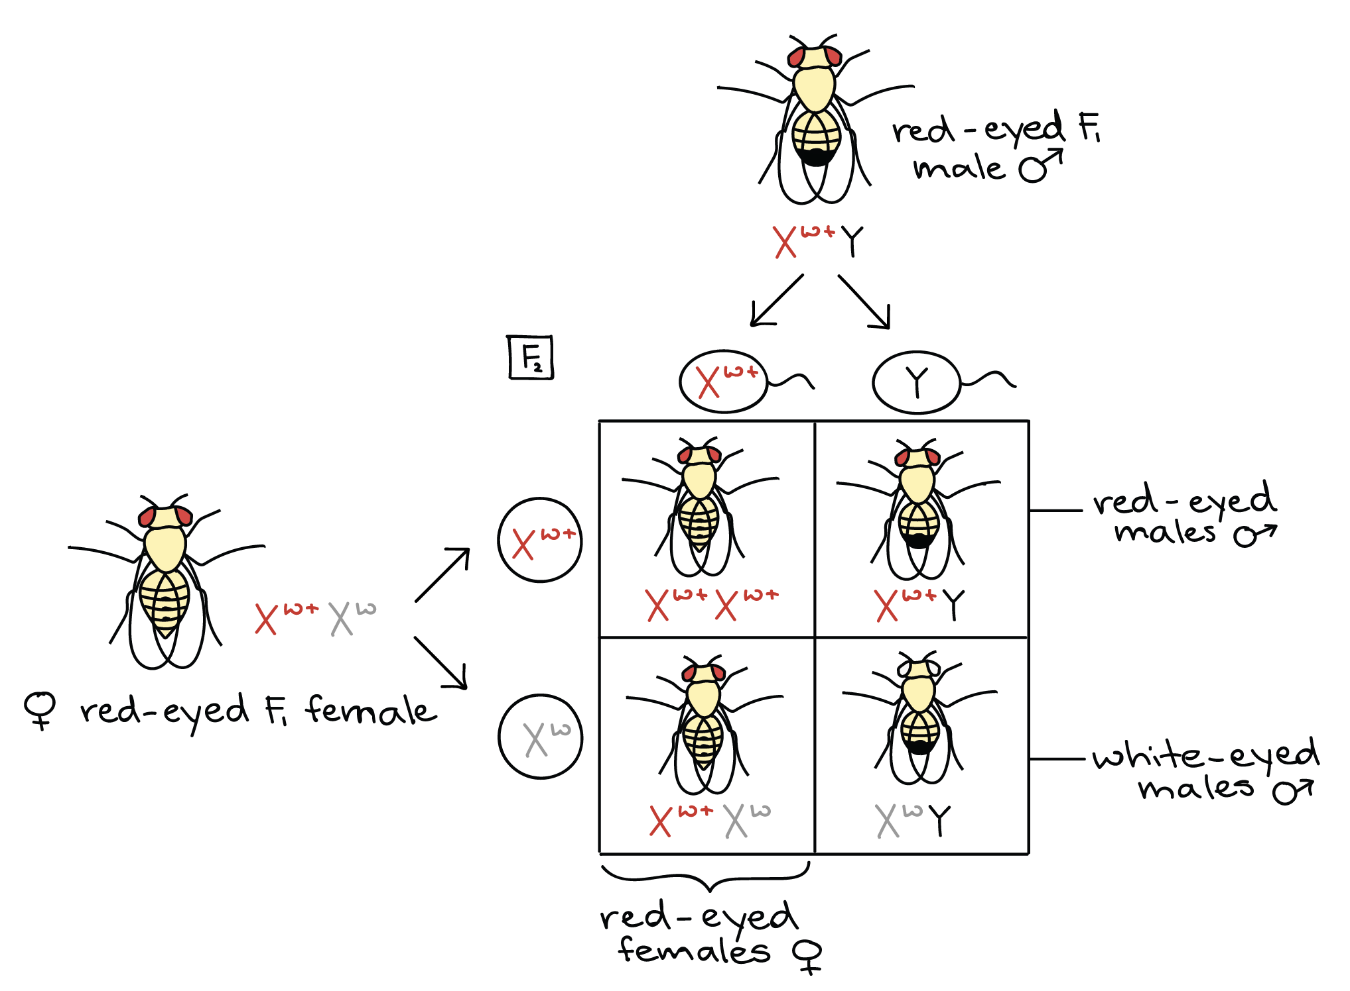

Slide 6
Gene linkage
Morgan went on to identify a number of different traits in fruit flies that did not conform to Mendelian ratios 9:3:3:1.
But the results showed that some traits appeared to be inherited together and did not independently assort. Morgan called these traits linked traits, and concluded that linked genes were on the same chromosome.
Example: Long aristae and red eyes are more likely to be separated via recombination (high crossover frequency) but long aristae and long legs are less likely to be separated via recombination(low crossover frequency) . This indicates that the aristae and leg genes are located closer together, whereas the eye gene is more distant.

Slide 7
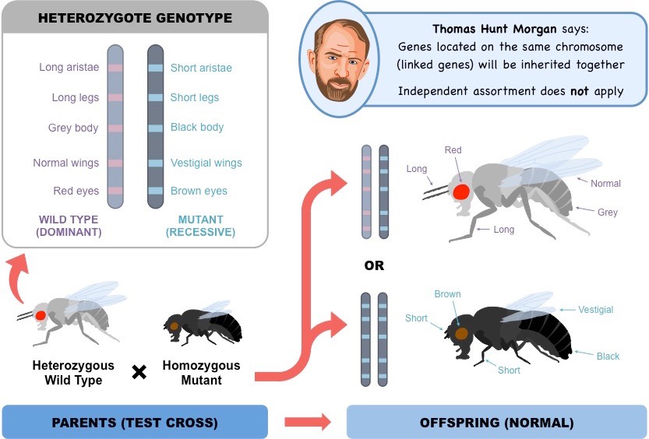

Slide 8
Linkage maps estimate distances between genes.
The probability that two genes on a chromosome will be inherited together is related to the distance between them. The closer together two genes are, the more likely it is that they will be inherited together. The farther apart two genes are, the more likely it is that they will be separated during meiosis.
One of Morgan’s students, Alfred Sturtevant, hypothesized that the frequency of cross-overs during meiosis was related to the distance between genes. This meant that the closer together two genes were, the more likely they were to stay together when cross-overs took place.

Slide 9
Linkage maps estimate distances between genes.
Sturtevant identified three linked traits in fruit flies—body color, eye color, and wing size—and then crossed the fruit flies. He recorded the percentage of times that the phenotypes did not appear together in the offspring. This percentage represented the frequency of cross-overs between chromosomes.
From the cross-over frequencies, Sturtevant made linkage maps, which are maps of the relative locations, or loci, of genes on a chromosome. On a linkage map, one map unit is equal to one cross-over for each 100 offspring, or one percentage point.
Making a linkage map is fairly easy if all of the cross-over frequencies for the genes being studied are known. Suppose the following data were collected.
• Gene A and gene B cross over 6.0% of the time.
• Gene B and gene C cross over 12.5% of the time.
• Gene A and gene C cross over 18.5% of the time.
According to Sturtevant’s conclusions, genes A and B are 6 map units apart because they cross over 6% of the time. Similarly, genes B and C are 12.5 map units apart because they cross over 12.5% of the time.

Slide 10
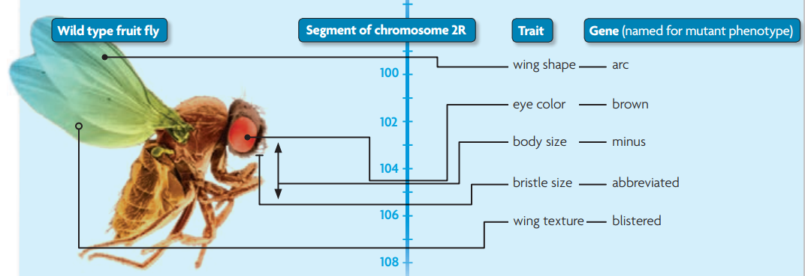
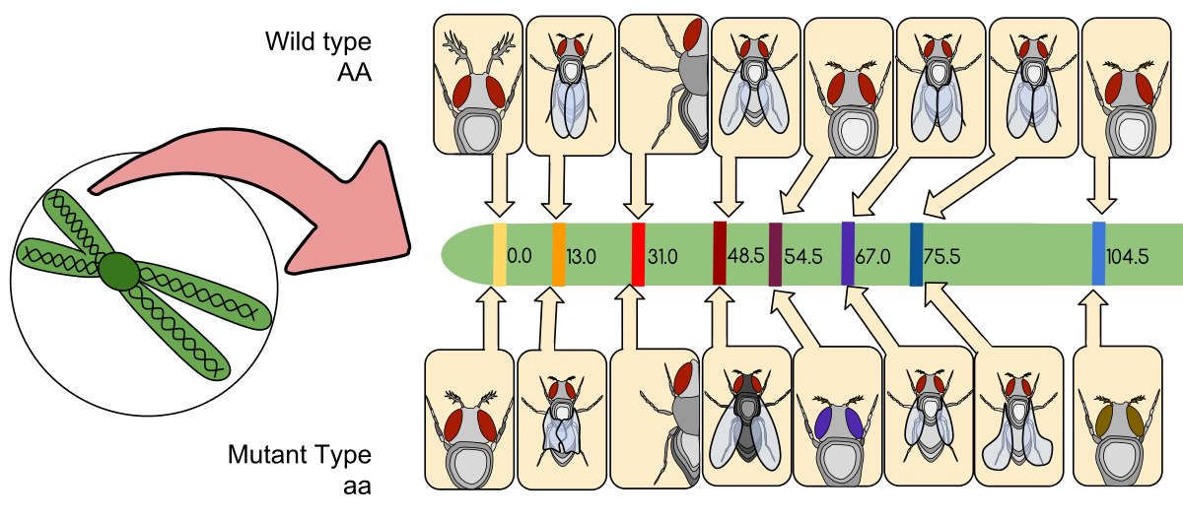
Linkage maps estimate distances between genes.

Slide 11
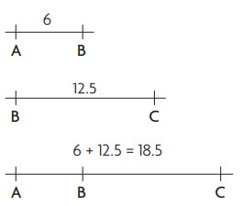
Linkage maps estimate distances between genes.
Think about gene A as a point on a line. Gene B is either to the left or to the right of gene A. The same is true of the relationship between genes B and C. But if you only know the distances between genes A and B, and between genes B and C, you cannot determine the order of all three genes. You must also know the distance between genes A and C.
The map distances between genes A and B and between genes B and C equal the map distance between genes A and C. Therefore, gene B must be located between genes A and C. If the map distance between genes A and C were 6.5 map units instead of 18.5 map units, then gene A would be between genes B and C.
Although linkage maps show the relative locations of linked genes, the maps do not show actual physical distances between genes. Linkage maps can give you a general idea about distances between genes.

Slide 12
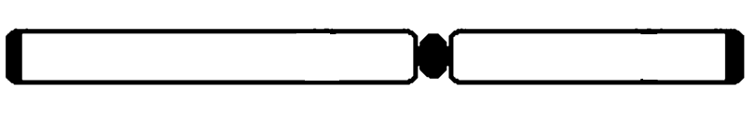
Linkage maps estimate distances between genes.
If we had genes A, B and C. After checking the table showing the recombination frequency, this is how we can map the chromosome or place the genes on the chromosome.
Genes | Recombination
A-B | 17%
A-C | 8%
C-B | 9%
A
C
B

Slide 13
Linkage maps estimate distances between genes.
If we had genes A, B, C and D. After checking the table showing the recombination frequency, how can you place the genes on the chromosome?
P.S: The total distance of the chromosome is 50 map units.
Genes | Recombination
A-B | 30%
B-C | 45%
B-D | 40%
A-D | 25%

